Slide 1
PYTHON : PROGRAMMING LANGUAGE FOR FUTURE!
Premanand S
School of Electronics Engineering (SENSE)
Vellore Institute of Engineering, Chennai campus

Slide 2
PYTHON – FOR LOOP

Slide 3
Definite Loops
Quite often we have a list of items of the lines in a file - effectively a finite set of things
We can write a loop to run the loop once for each of the items in a set using the Python for construct
These loops are called “definite loops” because they execute an exact number of times
We say that “definite loops iterate through the members of a set”

Slide 4
A Simple Definite Loop
5
4
3
2
1
Blastoff!
for i in [5, 4, 3, 2, 1] :
print(i)
print('Blastoff!’))

Slide 5
A Definite Loop with Strings
Happy New Year: Joseph
Happy New Year: Glenn
Happy New Year: Sally
Done!
friends = ['Joseph', 'Glenn', 'Sally']
for friend in friends :
print('Happy New Year:', friend))
print('Done!’))

Slide 6
A Simple Definite Loop
Yes
Done?
No
Move i ahead
5
4
3
2
1
Blastoff!
for i in [5, 4, 3, 2, 1] :
print(i))
print('Blastoff!’))
print(i))
Definite loops (for loops) have explicit iteration variables that change each time through a loop. These iteration variables move through the sequence or set.
print('Blast off!')

Slide 7
Looking at in...
The iteration variable “iterates” through the sequence (ordered set)
The block (body) of code is executed once for each value in the sequence
The iteration variable moves through all of the values in the sequence
Five-element sequence
Iteration variable
for i in [5, 4, 3, 2, 1] :
print(i)

Slide 8
No
Yes
Done?
The iteration variable “iterates” through the sequence (ordered set)
The block (body) of code is executed once for each value in the sequence
The iteration variable moves through all of the values in the sequence
Move i ahead
print(i))
for i in [5, 4, 3, 2, 1] :
print(i))

Slide 9
i = 5
No
Yes
Done?
print(i)
Move i ahead
i = 4
print(i)
print(i)
i = 3
print(i)
i = 2
for i in [5, 4, 3, 2, 1] :
print(i)
print(i)
i = 1
print(i)

Slide 10
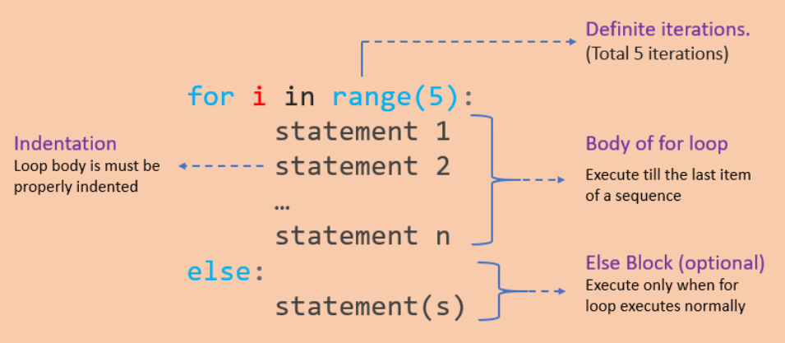
FOR LOOP
Used to iterate over a sequence like list, tuple, string or other
Loop continues until we reach the last item in the sequence
Identation

Slide 11
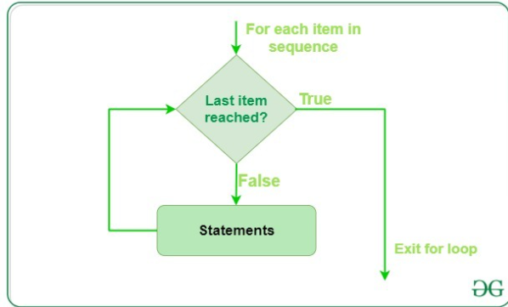
FOR LOOP – FLOW CONTROL

Slide 12
RANGE()
Generate a sequence of numbers using range() function
range(start, stop,step_size)
Not an iterator since it supports in, len and __getitem__ operations

Slide 13
FOR…ELSE STATEMENT
for...else statement can be used with the break keyword to run the else block only when the break keyword was not executed

Slide 14
Making “smart” loops
The trick is “knowing” something about the whole loop when you are stuck writing code that only sees one entry at a time
Set some variables to initial values
for thing in data:
Look for something or do something to each entry separately, updating a variable
Look at the variables

Slide 15
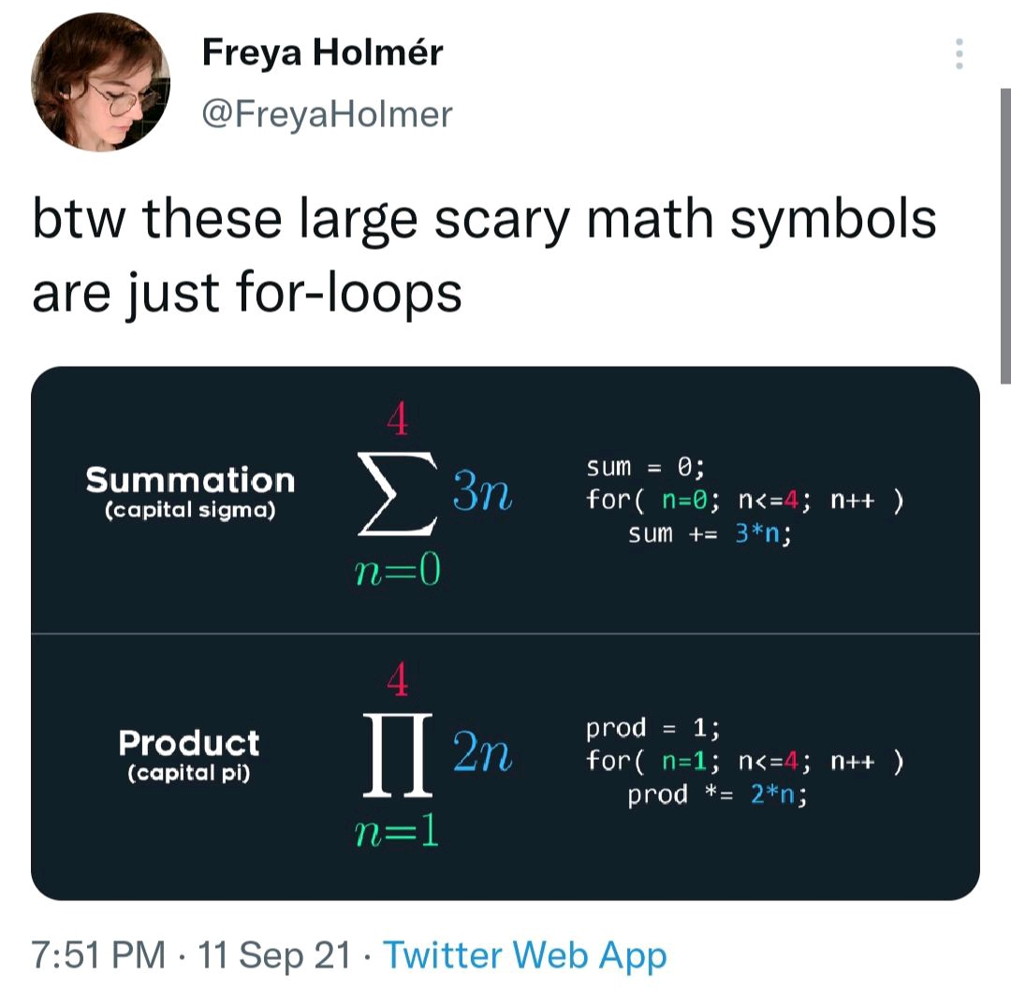
HOW EFFECTIVE OF USING FOR LOOP – MEME EXPLANATION

Slide 16
Counting in a Loop
$ python countloop.py
Before 0
1 9
2 41
3 12
4 3
5 74
6 15
After 6
zork = 0
print('Before', zork)
for thing in [9, 41, 12, 3, 74, 15] :
zork = zork + 1
print(zork, thing)
print('After', zork)
To count how many times we execute a loop, we introduce a counter variable that starts at 0 and we add one to it each time through the loop.

Slide 17
Summing in a Loop
$ python countloop.py
Before 0
9 9
50 41
62 12
65 3
139 74
154 15
After 154
zork = 0
print('Before', zork)
for thing in [9, 41, 12, 3, 74, 15] :
zork = zork + thing
print(zork, thing)
print('After', zork)
To add up a value we encounter in a loop, we introduce a sum variable that starts at 0 and we add the value to the sum each time through the loop.

Slide 18
Finding the Average in a Loop
$ python averageloop.py
Before 0 0
1 9 9
2 50 41
3 62 12
4 65 3
5 139 74
6 154 15
After 6 154 25.666
count = 0
sum = 0
print('Before', count, sum)
for value in [9, 41, 12, 3, 74, 15] :
count = count + 1
sum = sum + value
print(count, sum, value)
print('After', count, sum, sum / count)
An average just combines the counting and sum patterns and divides when the loop is done.

Slide 19
Filtering in a Loop
print('Before')
for value in [9, 41, 12, 3, 74, 15] :
if value > 20:
print('Large number',value)
print('After')
$ python search1.py
Before
Large number 41
Large number 74
After
We use an if statement in the loop to catch / filter the values we are looking for.

Slide 20
Search Using a Boolean Variable
$ python search1.py
Before False
False 9
False 41
False 12
True 3
True 74
True 15
After True
found = False
print('Before', found)
for value in [9, 41, 12, 3, 74, 15] :
if value == 3 :
found = True
print(found, value)
print('After', found)
If we just want to search and know if a value was found, we use a variable that starts at False and is set to True as soon as we find what we are looking for.

Slide 21
HOW TO FIND THE SMALLEST VALUE
$ python largest.py
Before -1
9 9
41 41
41 12
41 3
74 74
74 15
After 74
largest_so_far = -1
print('Before', largest_so_far)
for the_num in [9, 41, 12, 3, 74, 15] :
if the_num > largest_so_far :
largest_so_far = the_num
print(largest_so_far, the_num)
print('After', largest_so_far)
How would we change this to make it find the smallest value in the list?

Slide 22
FINDING THE SMALLEST VALUE
smallest_so_far = -1
print('Before', smallest_so_far)
for the_num in [9, 41, 12, 3, 74, 15] :
if the_num < smallest_so_far :
smallest_so_far = the_num
print(smallest_so_far, the_num)
print('After', smallest_so_far)
We switched the variable name to smallest_so_far and switched the > to <

Slide 23
FINDING THE SMALLEST VALUE
$ python smallbad.py
Before -1
-1 9
-1 41
-1 12
-1 3
-1 74
-1 15
After -1
smallest_so_far = -1
print('Before', smallest_so_far)
for the_num in [9, 41, 12, 3, 74, 15] :
if the_num < smallest_so_far :
smallest_so_far = the_num
print(smallest_so_far, the_num)
print('After', smallest_so_far)
We switched the variable name to smallest_so_far and switched the > to <

Slide 24
FINDING THE SMALLEST VALUE
smallest = None
print('Before')
for value in [9, 41, 12, 3, 74, 15] :
if smallest is None :
smallest = value
elif value < smallest :
smallest = value
print(smallest, value)
print('After', smallest)
$ python smallest.py
Before
9 9
9 41
9 12
3 3
3 74
3 15
After 3
We still have a variable that is the smallest so far. The first time through the loop smallest is None, so we take the first value to be the smallest.

Slide 25
The is and is not Operators
Python has an is operator that can be used in logical expressions
Implies “is the same as”
Similar to, but stronger than ==
is not also is a logical operator
smallest = None
print('Before')
for value in [3, 41, 12, 9, 74, 15] :
if smallest is None :
smallest = value
elif value < smallest :
smallest = value
print(smallest, value)
print('After', smallest)

Slide 26
ASSIGNMENTS
Write a program that uses a for loop to print all the even numbers from 1 to 50.
Create a program that calculates the sum of all numbers from 1 to 100 using a for loop.
Build a program that prints a multiplication table for a given number. The table should display the multiplication of the given number from 1 to 10.
Write a program that takes a positive integer as input and checks if it's a prime number using a for loop. Provide appropriate output messages.

Slide 27
ASSIGNMENTS
Create a program that prints a pattern of asterisks in the shape of a right-angled triangle. The number of rows in the triangle should be specified by the user.
Build a program that calculates the factorial of a given number using a for loop. Display the result.
Write a program that generates the Fibonacci sequence up to a specified number of terms using a for loop.
Create a program that prompts the user for a positive integer and prints all the divisors of that number using a for loop.
Build a program that calculates and displays the factorial of each number in the range from 1 to 10 using a for loop.

Slide 28
ASSIGNMENT
Write a program that takes a sentence as input and counts the number of vowels (a, e, i, o, u) using a for loop.
Write a program that uses a for loop to search for a specific number within a list of numbers. If the number is found, print its index; otherwise, print "Number not found." Use the else statement to handle the case when the loop completes without finding the number.
Create a program that checks whether a given list of numbers is sorted in ascending order. If it is, print "List is sorted"; otherwise, print "List is not sorted." Use a for loop and the else statement.
Create a program that simulates a basic login system. Ask the user to enter their username and check if it matches a predefined list of usernames. If a match is found, print "Login successful"; otherwise, print "Login failed." Use a for loop with an else statement.

Slide 29
HAPPY LEARNING & HAPPY CODING!
WhatsApp +91 7358679961
Official: premanand.s@vit.ac.in
Personal: er.anandprem@gmail.com
Weblink: www.anandsdata.com
Github: https://github.com/anandprems
Linkedin: https://www.linkedin.com/in/premsanand/
Author @ Analytics Vidya: https://www.analyticsvidhya.com/blog/author/premanand17/

